Slide 1

Sensor Modeling in Sim2Real
Mingyuan Chi
Robotic Seminar
19.12.2023
19.12.2023

Slide 2
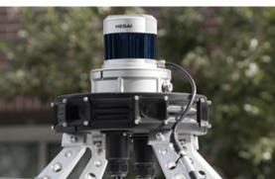
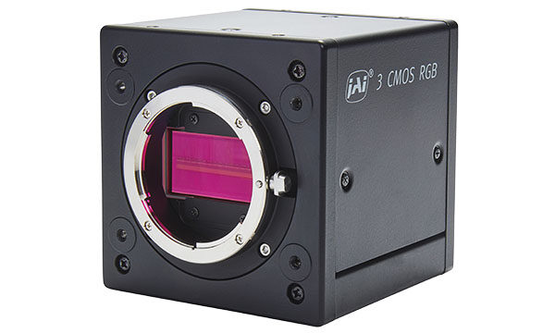
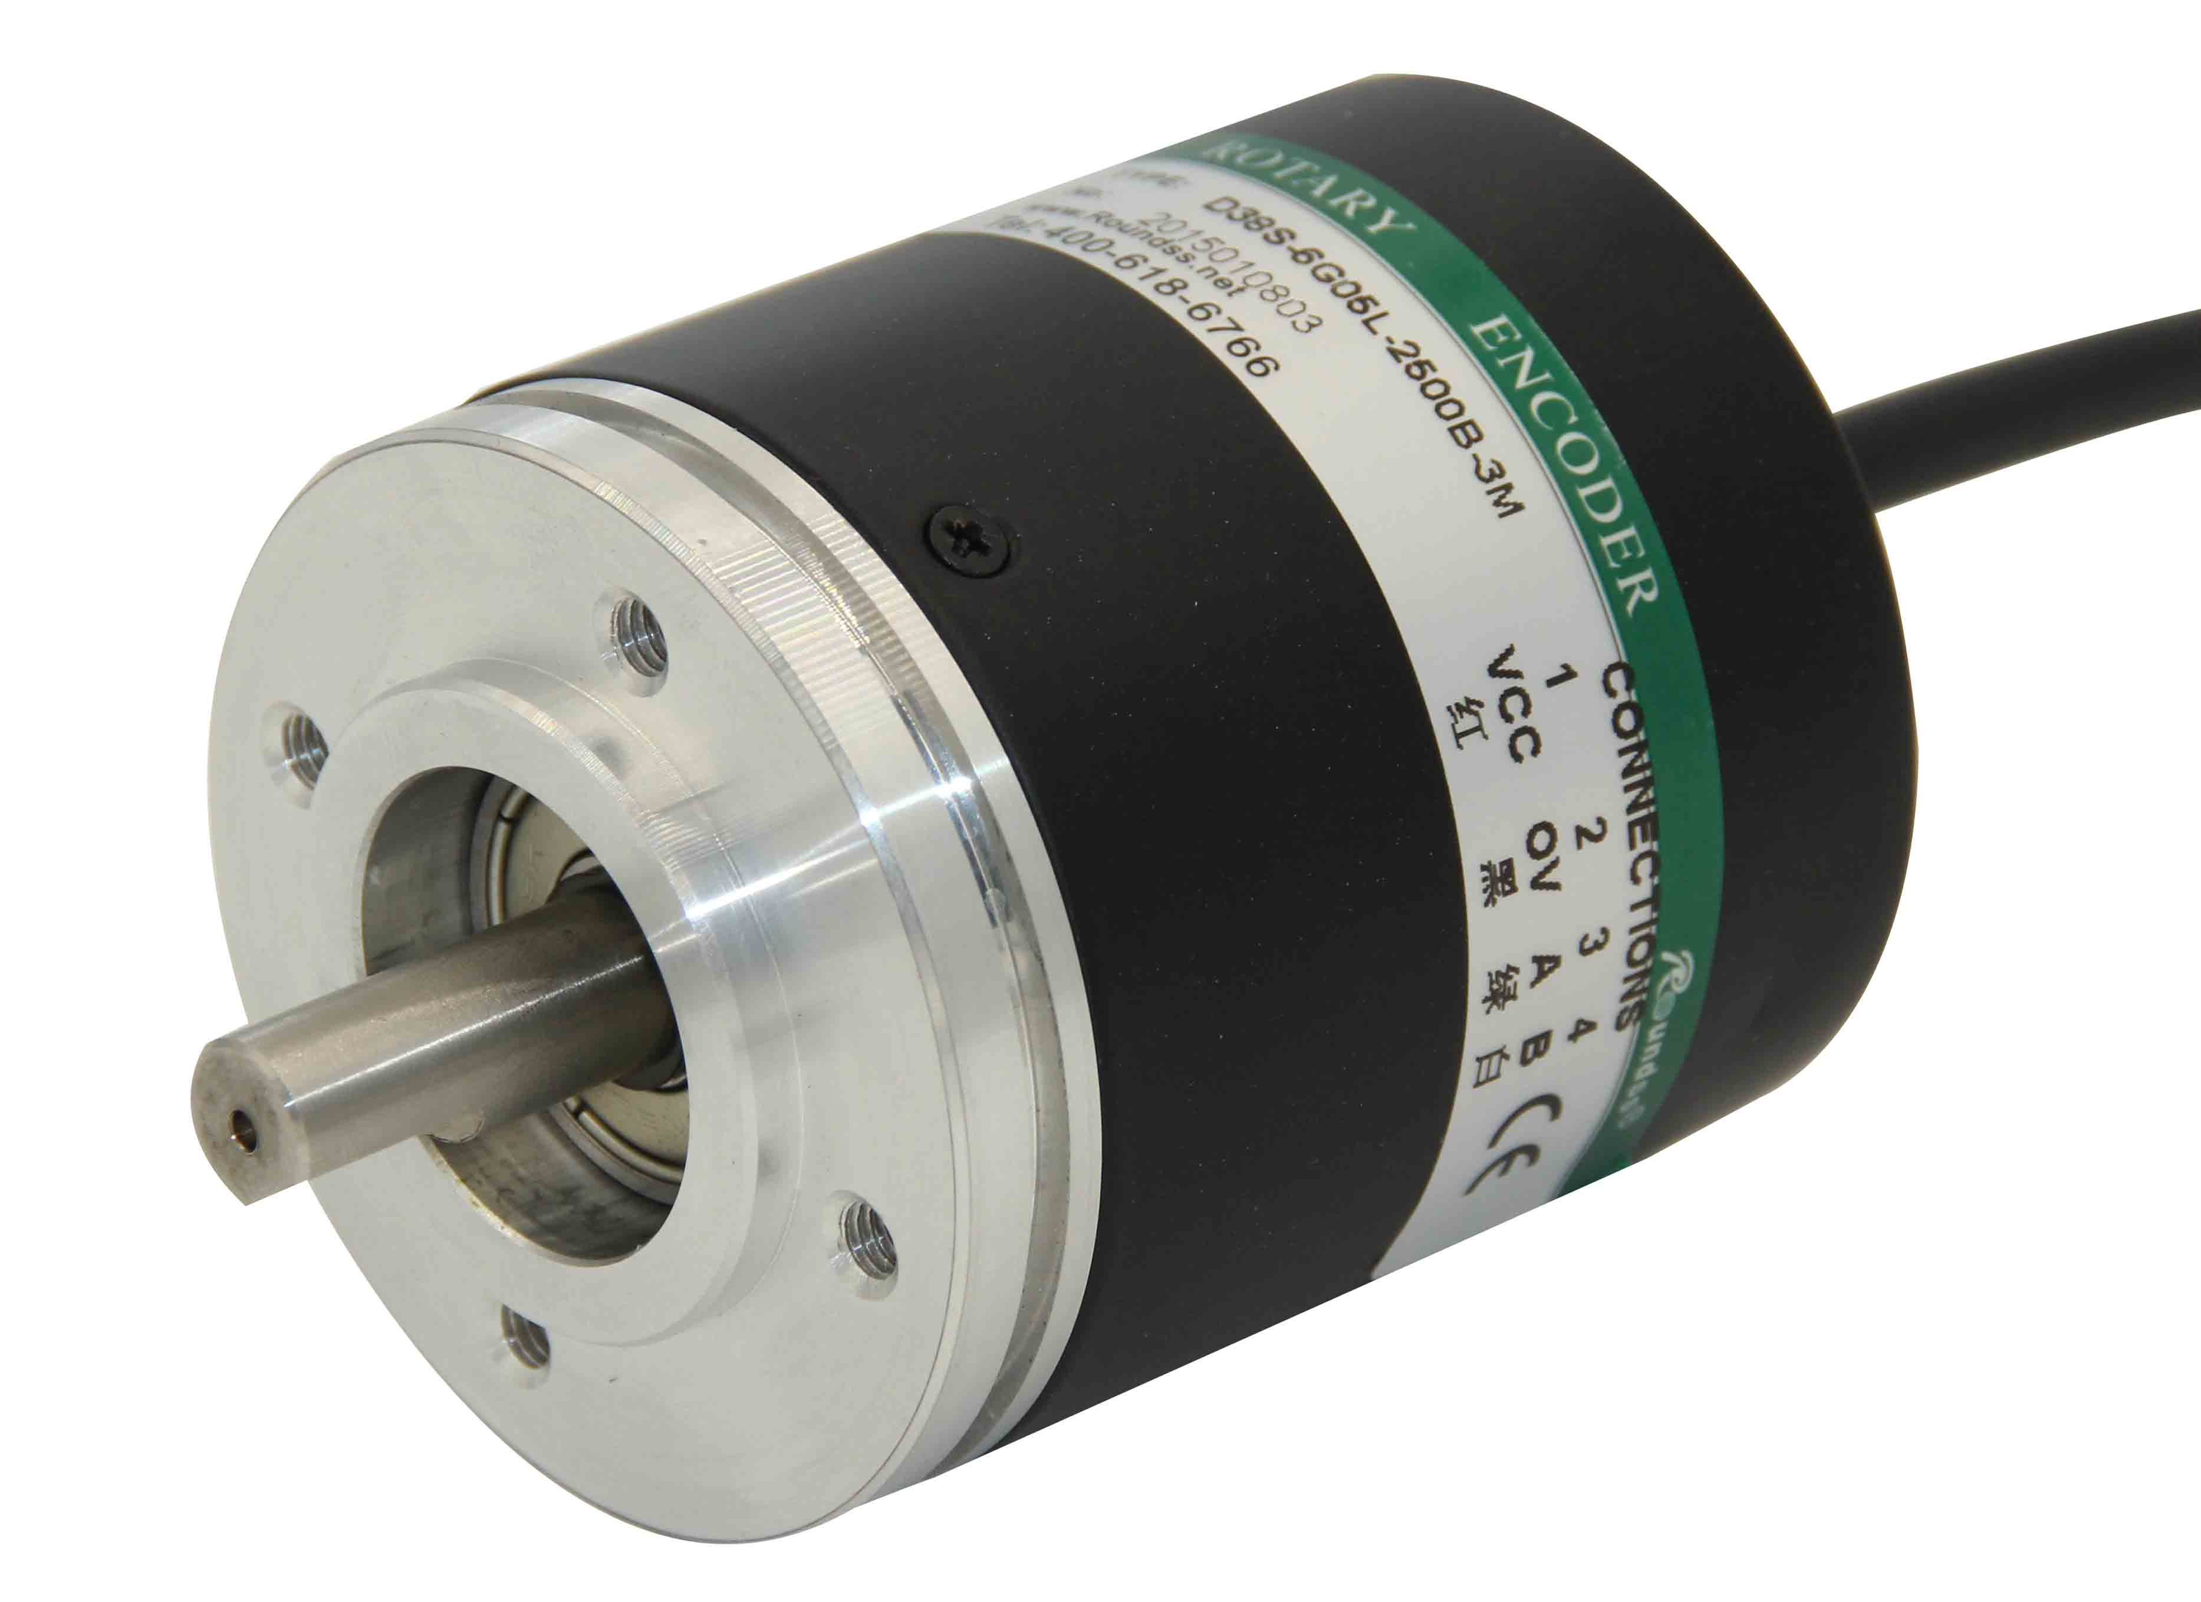
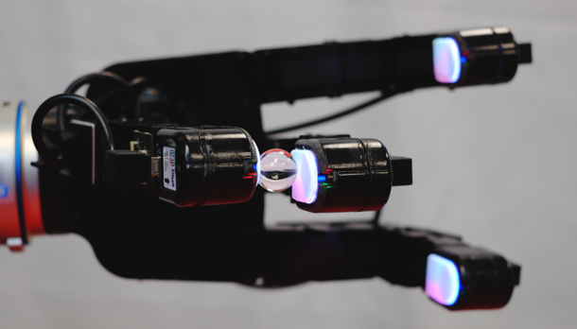
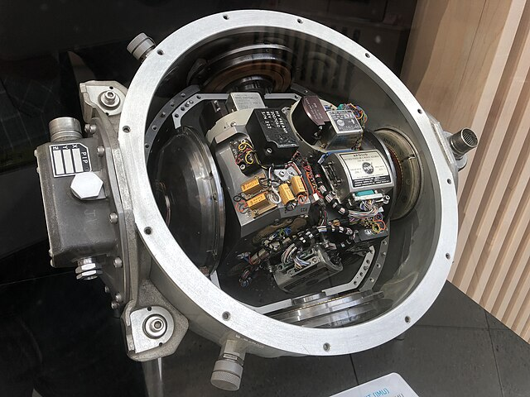
A.RGB Camera
B.Depth Sensor
C.IMU
D.Force Sensor
E.Encoder

Slide 3
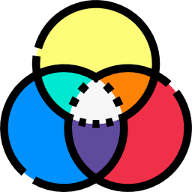
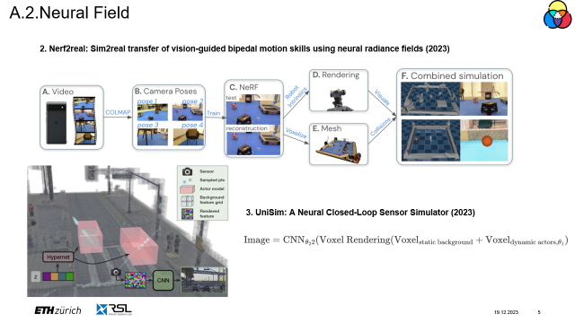
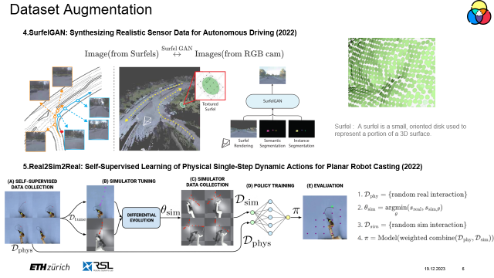
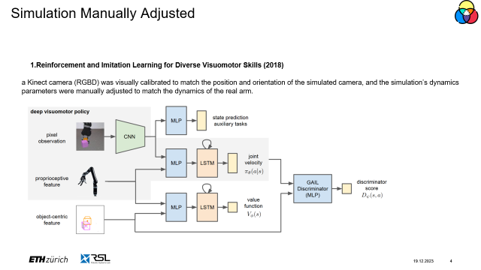
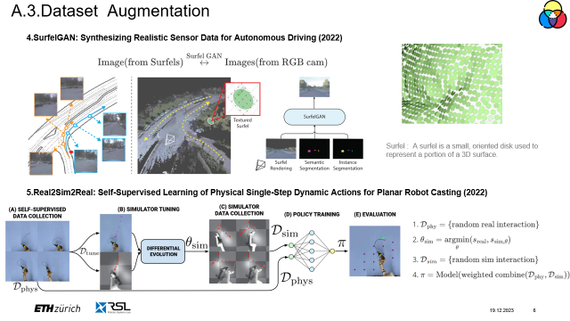
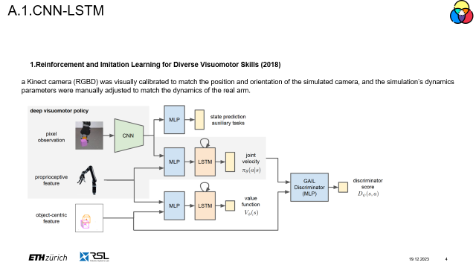
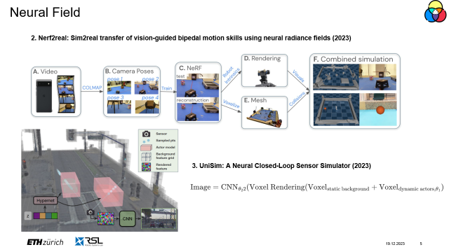
A. RGB Camera
A.1.CNN-LSTM
A.2.Neural Field
A.3.Dataset Augmentation

Slide 4
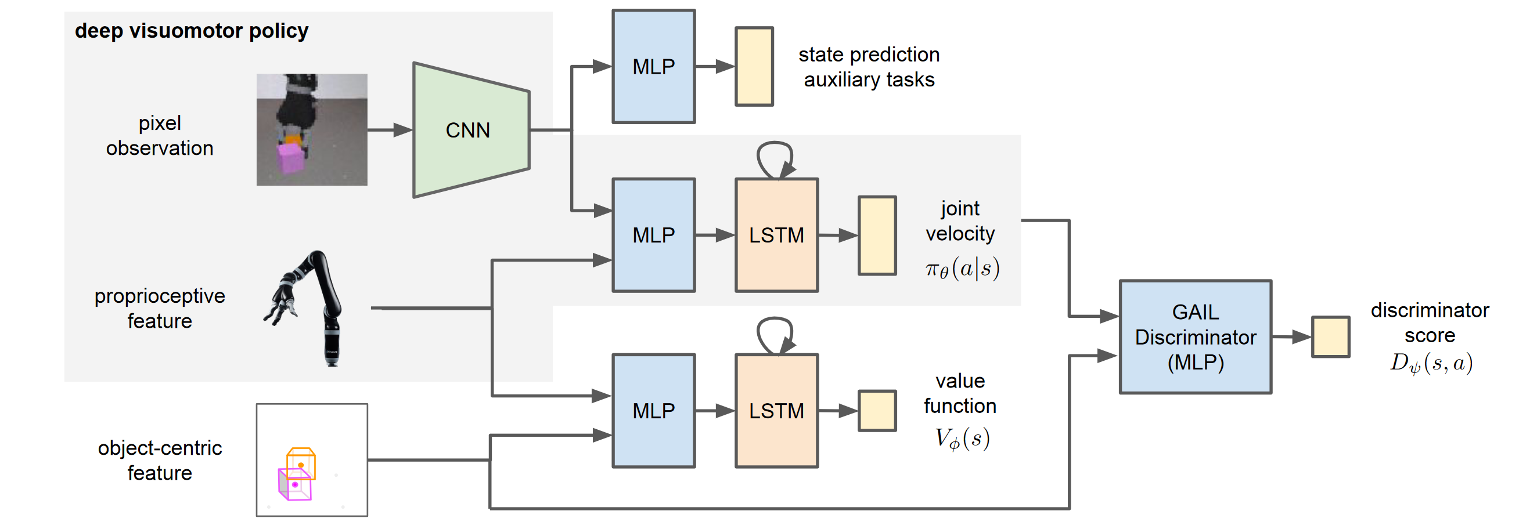
A.1.CNN-LSTM
1.Reinforcement and Imitation Learning for Diverse Visuomotor Skills (2018)
a Kinect camera (RGBD) was visually calibrated to match the position and orientation of the simulated camera, and the simulation’s dynamics parameters were manually adjusted to match the dynamics of the real arm.
Notes:
CNN + LSTM to handle the information from camera
intuitive
Gray part is the policy
Others are simulation
Advantage:
It could learn from the past (LSTM)
Limitation:
During the training, LiDAR is required
For object-centric feature
Manually adjustment
GAIL : Generative Adversarial Imitation Learning

Slide 5
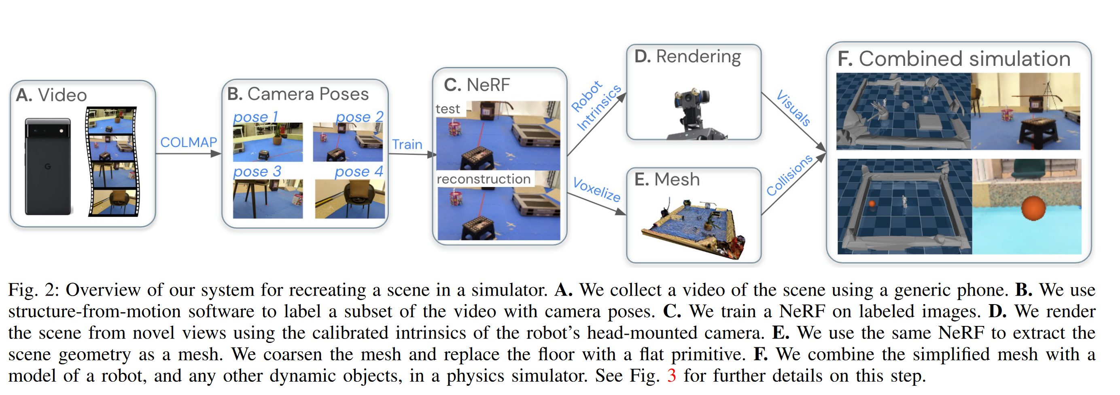
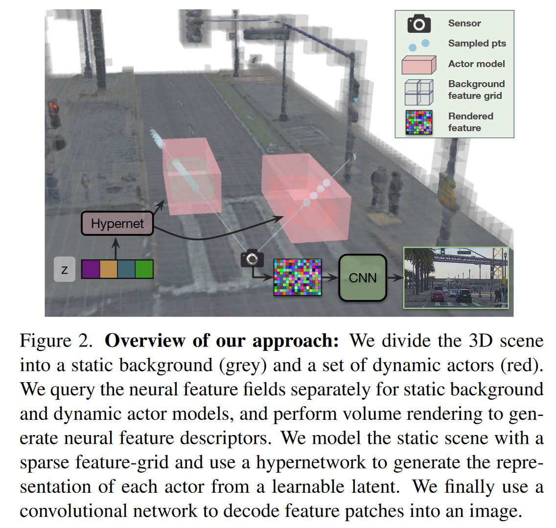
A.2.Neural Field
2. Nerf2real: Sim2real transfer of vision-guided bipedal motion skills using neural radiance fields (2023)
3. UniSim: A Neural Closed-Loop Sensor Simulator (2023)
Notes:
5-7 mins video
Camera pose : COLMAP
Simulator : dynamics object
Advantage:
High precision from Nerf
Easy to construct the environment (a generic phone)
Limitation
Manual postprocessing, robot camera -> simulator
Long time processing and high computational intensity
3. Dynamic (MuJoCo)-Static(Nerf) Object separation
fuse Dynamic + Static
Simulation Environment
Relation to Last Work:
1. Neural Scene
Advantage:
1. Less complexity (without training a Nerf)
2. couple dynamic objects and static objects
Limitation:
1. LiDAR required
Neural Sensor
CNN modeling
Closed loop simulation

Slide 6
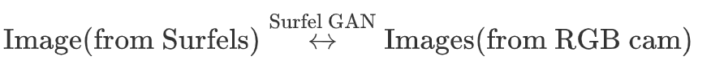
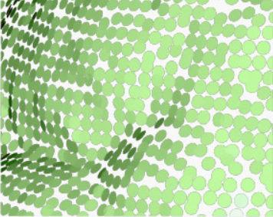
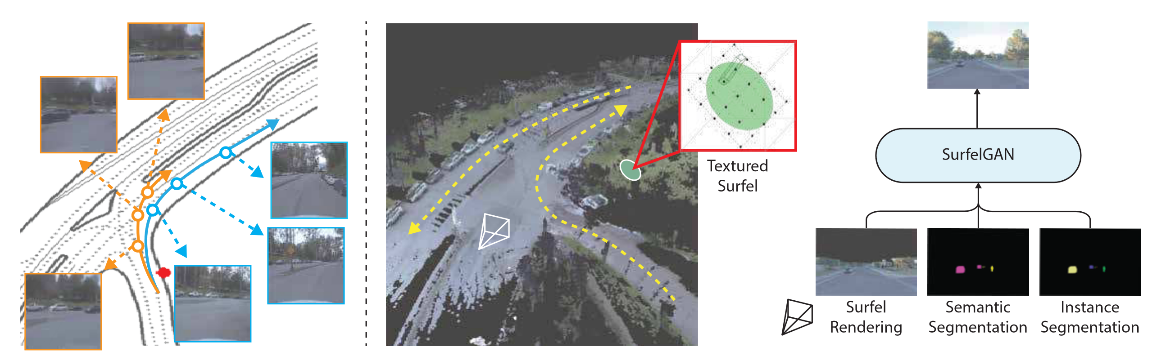
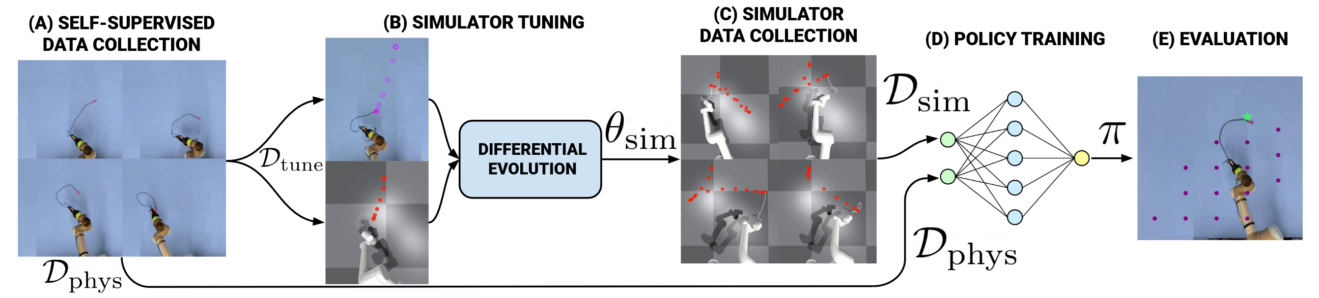
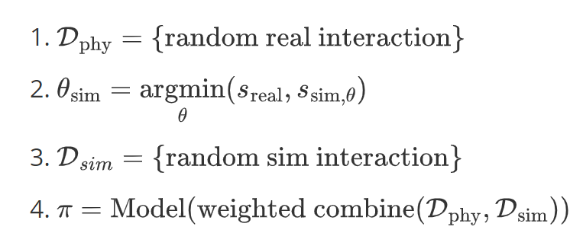
A.3.Dataset Augmentation
4.SurfelGAN: Synthesizing Realistic Sensor Data for Autonomous Driving (2022)
Surfel : A surfel is a small, oriented disk used to represent a portion of a 3D surface.
5.Real2Sim2Real: Self-Supervised Learning of Physical Single-Step Dynamic Actions for Planar Robot Casting (2022)
Notes:
Apart from environment creation,
Dataset Augmentation
Surfel is gained from LiDAR
SurfelGAN : (Surfel Rendered image + Segmentation) -> 2D camera image
Pupose: generate realistic image
Limitation :
1. unable to recover from broken geometry
2. Hallucination : surfel map doesn’t cover
Relationship To Last Work:
Dataset Augmentation
Pipeline :
first, generate a bunch of real world interactive dataset
second, sample a subset from it, and optimize the parameters in the simulation to close the gap between.
third, generate a bunch of simulation interactive dataset
last, combine reald interactive dataset and simulation interactive dataset to train the policy
Advantage:
1. simple and efficient
Limitation ：
1. can hard to extend to other task (Planar Robot Casting)

Slide 7

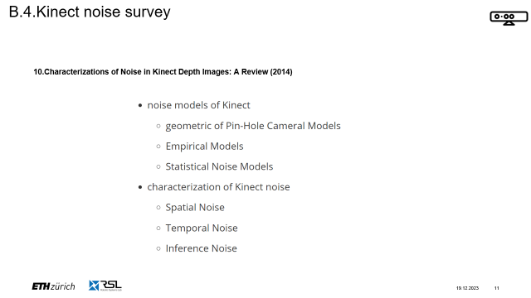
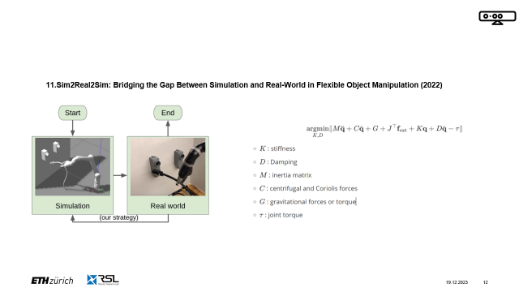
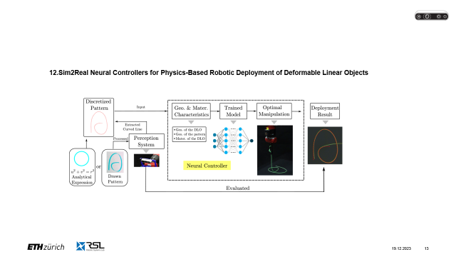
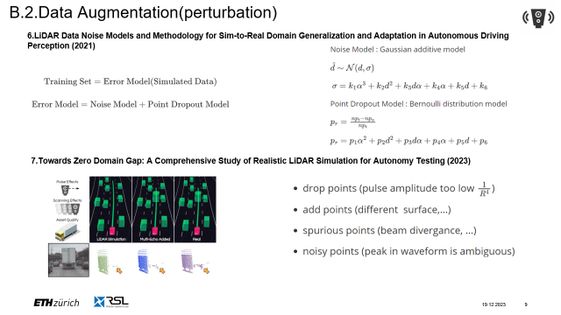
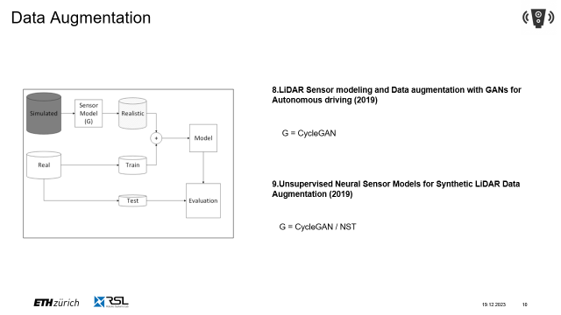
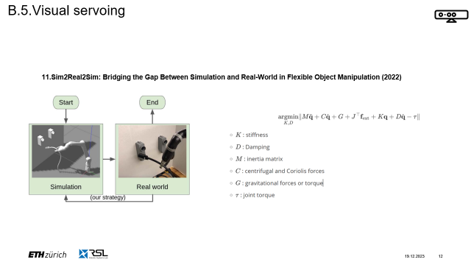
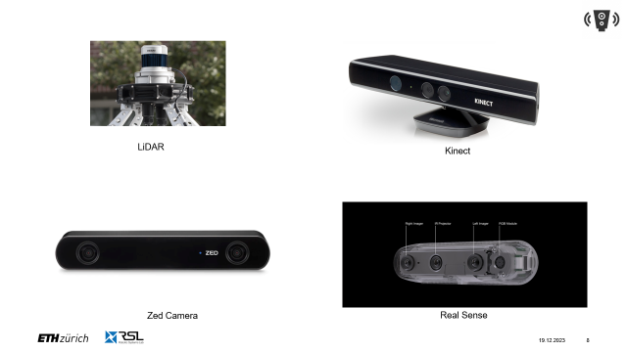
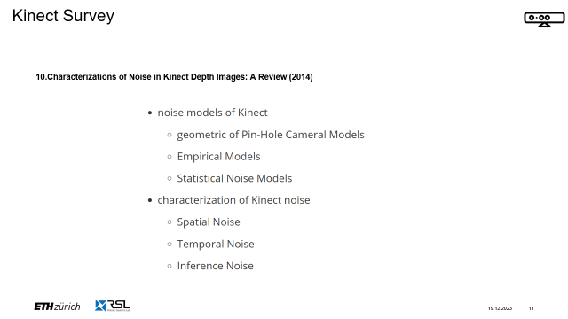
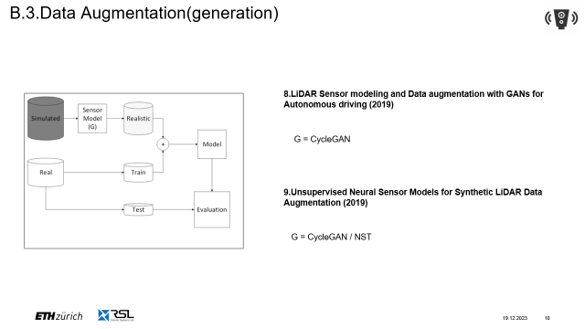
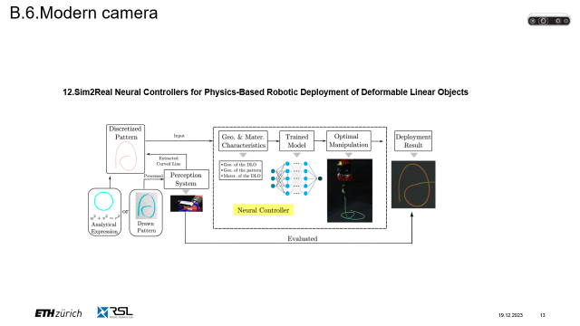

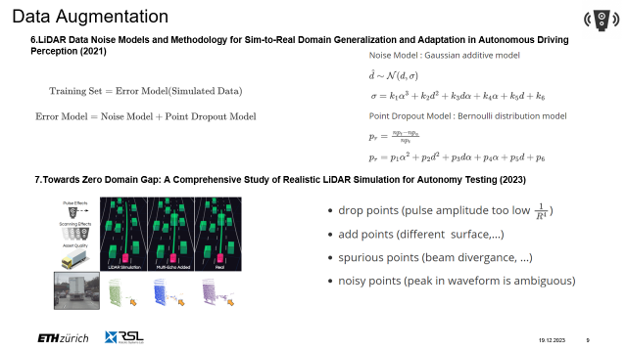
B. Depth Sensor
B.1.Categories
B.2.Data Augmentation(perturbation)
B.3.Data Augmentation(generation)
B.4.Kinect noise survey
B.5.Visual servoing
B.6.Modern camera

Slide 8
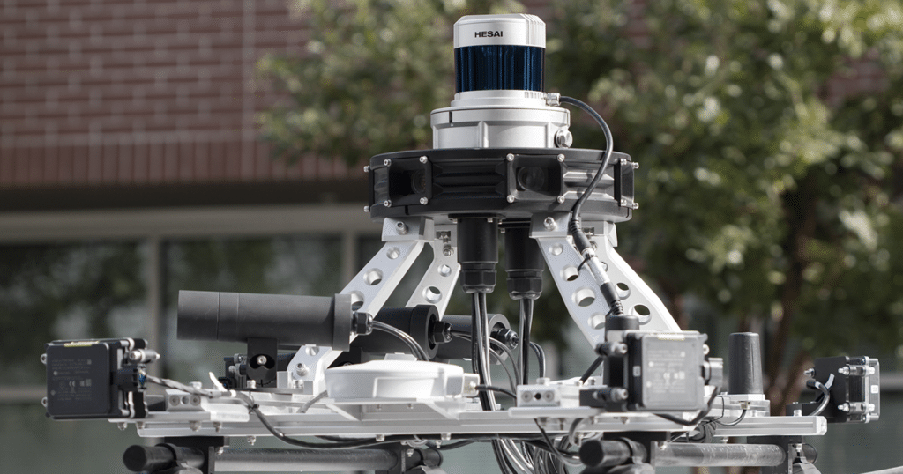
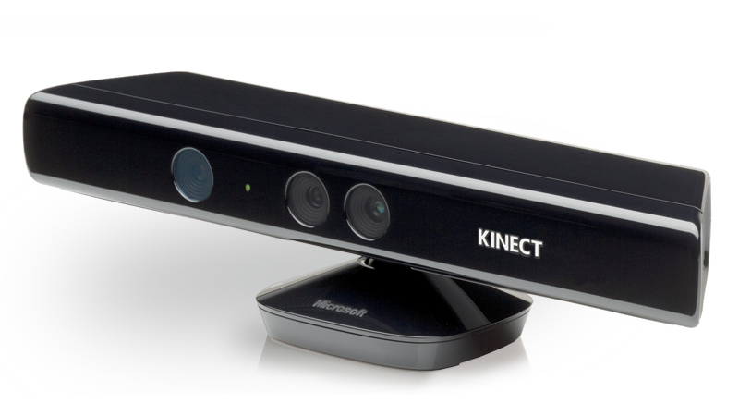
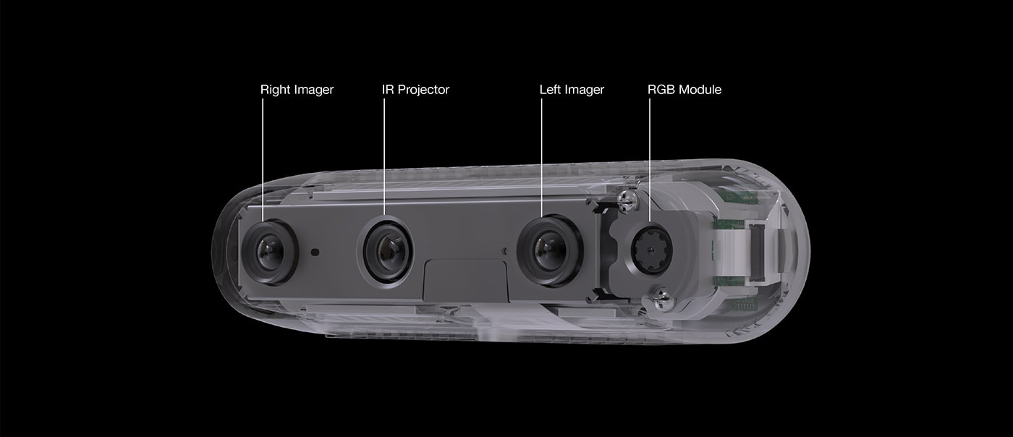
B.1.Categories
LiDAR
Kinect
Zed Camera
Real Sense
Notes:
RGB camera is always limited to one kind of information.
3D position

Slide 9
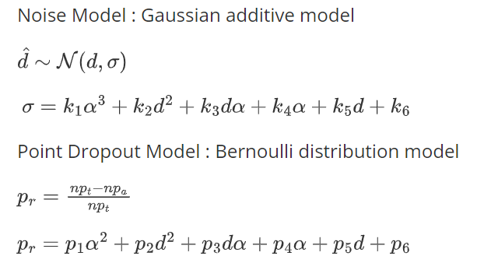
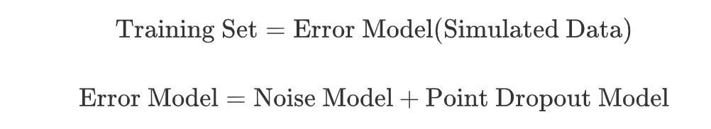
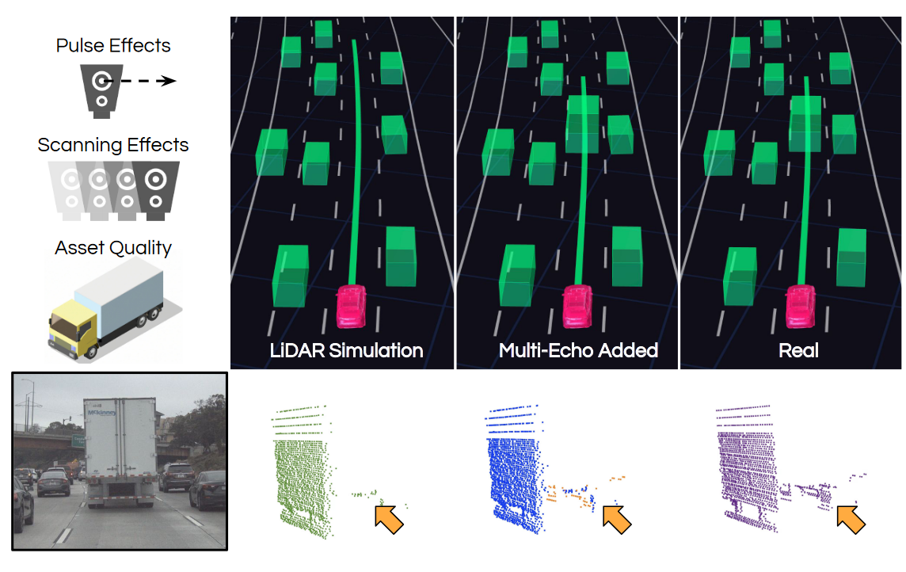
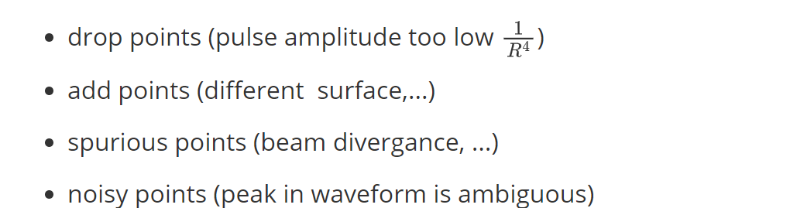
B.2.Data Augmentation(perturbation)
6.LiDAR Data Noise Models and Methodology for Sim-to-Real Domain Generalization and Adaptation in Autonomous Driving Perception (2021)
7.Towards Zero Domain Gap: A Comprehensive Study of Realistic LiDAR Simulation for Autonomy Testing (2023)
Notes:
Noise model for LiDAR
- noise points
- drop points
gaussian distribution
deviation of the gaussian model
Point dropout model
Bernoulli distribution
Quadratic polynomial
===================
As for LiDAR
Uncertainty Phenomenon
Unreturned pulse because of fast amplitude decay
Multiple echos caused by multiple surfaces
Spurious returns caused by beam divergence
Noisy points caused by ambiguity in wavepeak

Slide 10
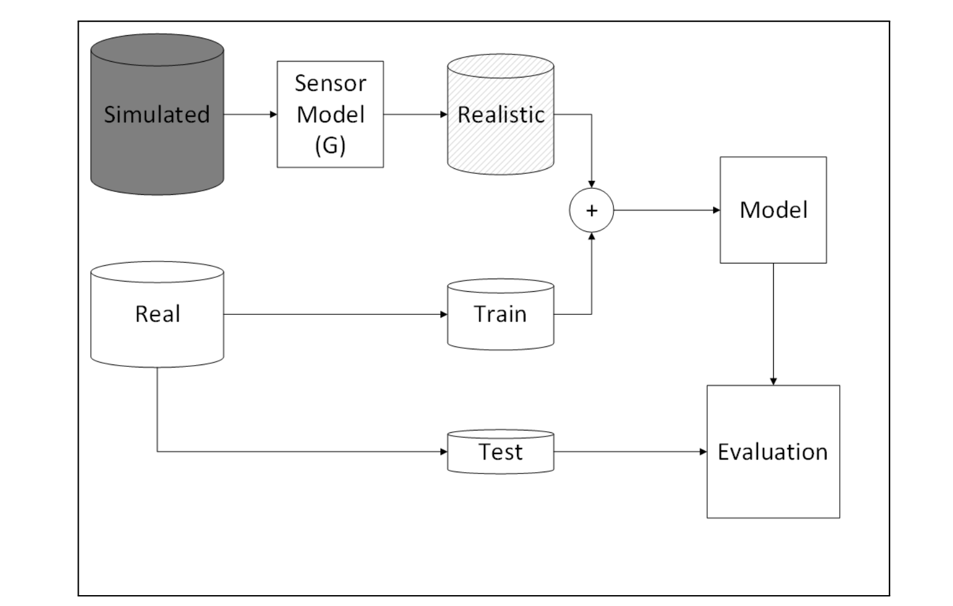
B.3.Data Augmentation(generation)
8.LiDAR Sensor modeling and Data augmentation with GANs for Autonomous driving (2019)
G = CycleGAN
9.Unsupervised Neural Sensor Models for Synthetic LiDAR Data Augmentation (2019)
G = CycleGAN / NST
Notes:
Neural Network Modeling
Similar to SurfelGAN
Model the transition from simulated LiDAR to sim LiDAR using Cycle GAN
Generate high realistic LiDAR
Futher from (same author) last work
Here, they use a general generation model which can be CycleGAN, Neural Style Transfer
The total trainig dataset is the combination of realistic dataset and augmented dataset

Slide 11

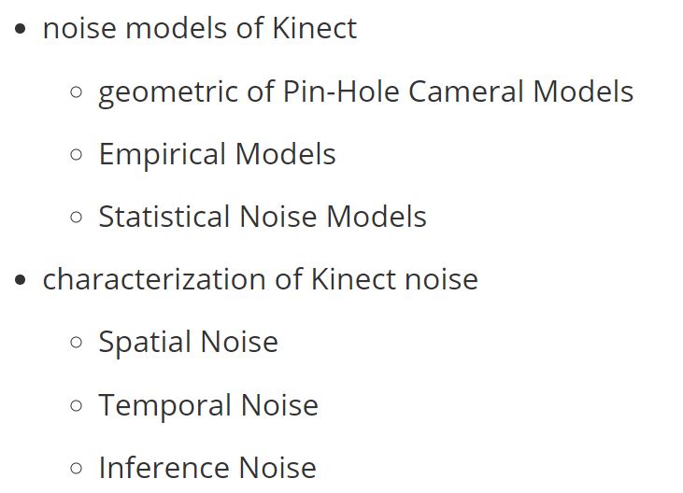
B.4.Kinect noise survey
10.Characterizations of Noise in Kinect Depth Images: A Review (2014)
Notes:
There is also a work provide the sensor modeling for Kinect.
Based on these modeling, they could sperate the noise into three categories

Slide 12
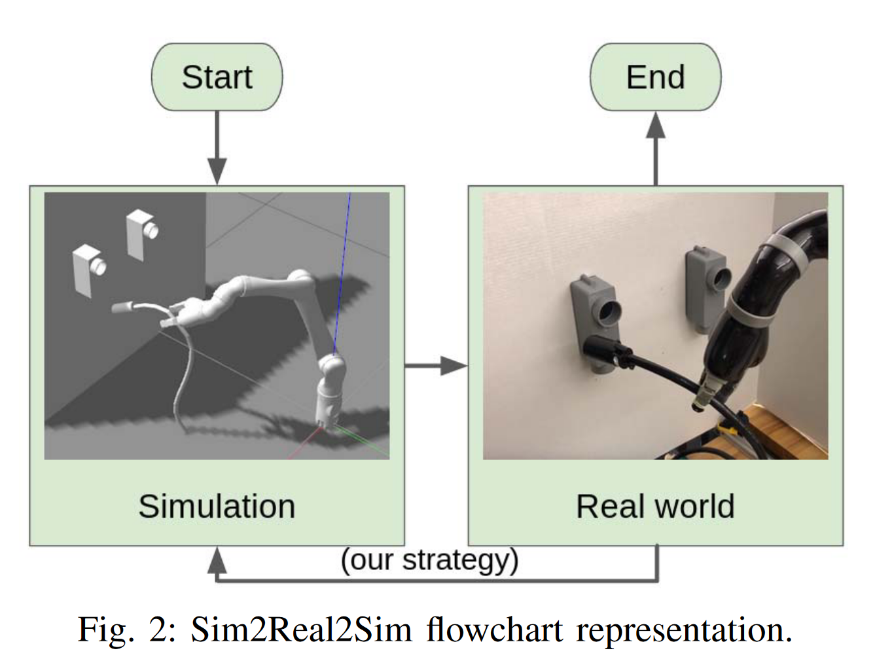
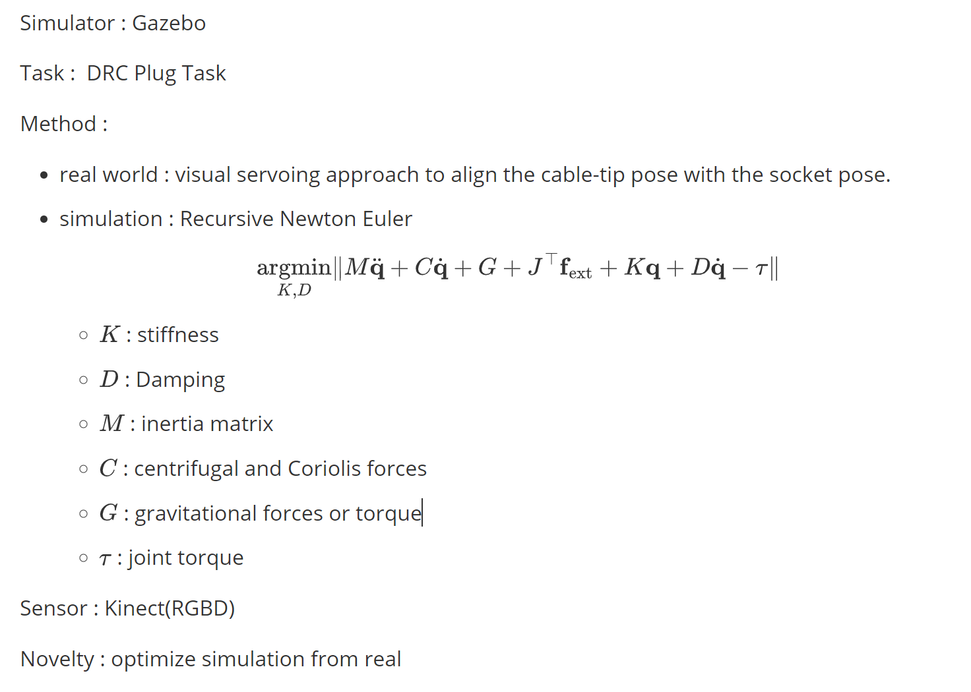
B.5.Visual servoing
11.Sim2Real2Sim: Bridging the Gap Between Simulation and Real-World in Flexible Object Manipulation (2022)
Notes:
The work sim2real2sim focus on DRC(DARPA Robotics Challenge) Plug task
They use a visual servoing approach, which uses the reverse Jacobian of the difference between preinsert frame and cable tip frame to align the pose. Therefore, it could update the parameters in the simulation.

Slide 13
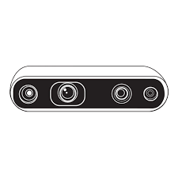
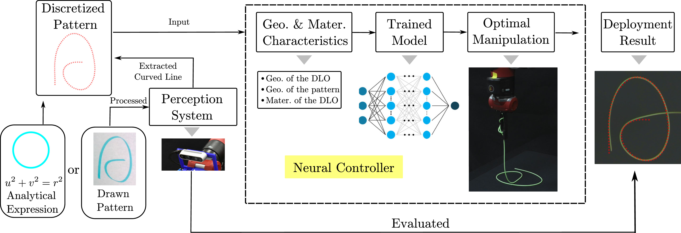
B.6.Modern camera
12.Sim2Real Neural Controllers for Physics-Based Robotic Deployment of Deformable Linear Objects
Notes:
As for the modern camera, Realsense
This work focus on Deformed Linear Objects Problem.
The 3D position of the nodes on the linear objects are directly gained from the RealSense camera

Slide 14

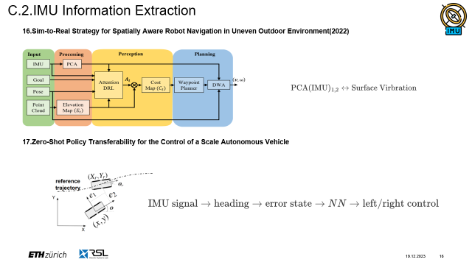
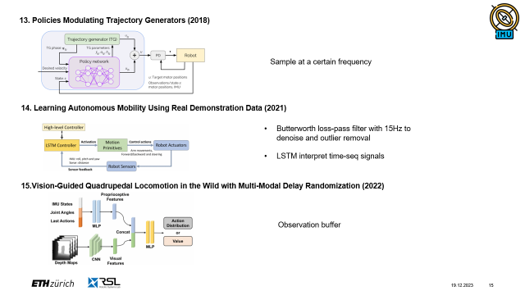
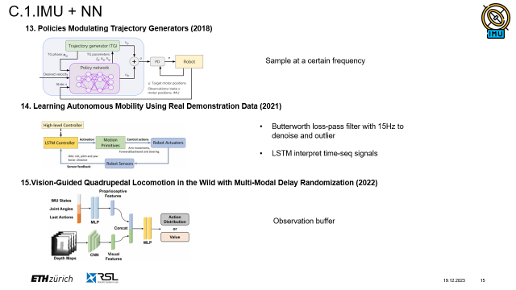
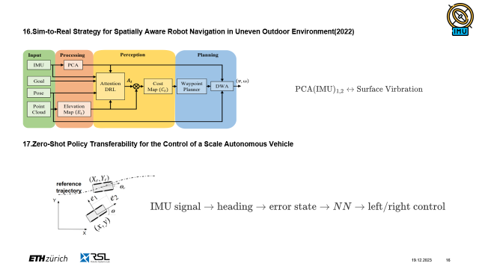
C. IMU
C.1.IMU + NN
C.2.IMU Information Extraction

Slide 15
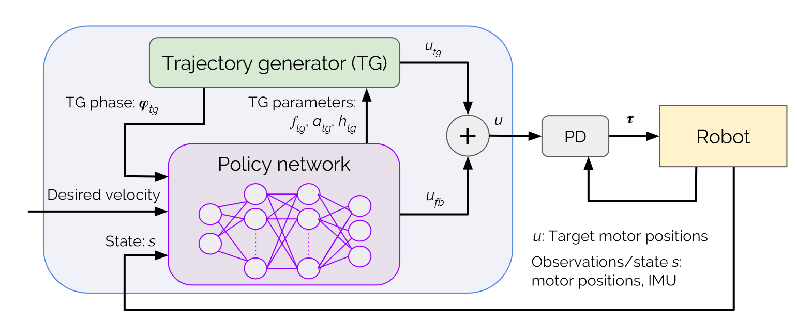
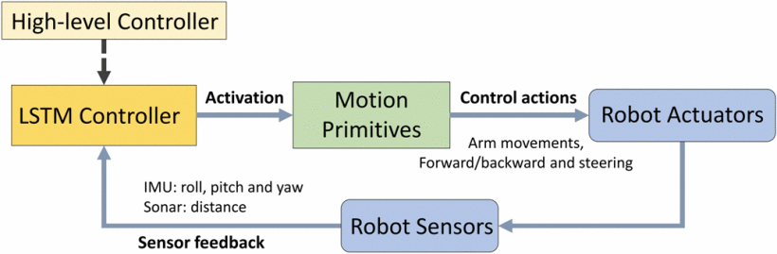

C.1.IMU + NN
13. Policies Modulating Trajectory Generators (2018)
Sample at a certain frequency
14. Learning Autonomous Mobility Using Real Demonstration Data (2021)
Butterworth loss-pass filter with 15Hz to denoise and outlier
LSTM interpret time-seq signals
15.Vision-Guided Quadrupedal Locomotion in the Wild with Multi-Modal Delay Randomization (2022)
Observation buffer
Notes:
Interial Measurement Unit is primarily used for measuring acceleration.
It’s always used with other sensors like RGBD cam and encoders.
The signal frequencies are different.
Constant frequency sampling. -> policy network
Loss the information in the interval
To better use the high frequency signal
Butterworth low-pass filter with 15Hz to denoise and outlier removal.
LSTM controller to interpret these time-seq signals
The policy could only work at a low frequency
Visual observation buffer, which buffer the depth information to make it synchronous with IMU signals
High frequency.

Slide 16



C.2.IMU Information Extraction
16.Sim-to-Real Strategy for Spatially Aware Robot Navigation in Uneven Outdoor Environment(2022)
17.Zero-Shot Policy Transferability for the Control of a Scale Autonomous Vehicle
Notes:
Extract information from IMU
Extract surface vibration using PCA
First two principle components.
IMU -> heading information
Extract error state combined with GPS signals
IMU -> EKF
Error state-> model predictive controller -> navigation accuracy
Dynamic Window Approach penalize velocity prevent from flip-over.

Slide 17









D. Force Sensor
D.1.Review
D.2.Numerical Approach
D.3.FEM simulation
D.4.Dataset Augmentation

Slide 18




D.1.Review
18.Robotic tactile perception of object properties: A review (2017)
Single-point contact sensor :
measure contact force : ATI Nano 17 force-torque sensor
measure vibration : biomimeticwhiskers
Tactile Array: fiber optics, MEMS barometers, RoboTouch, DigiTacts
optical tactile sensor, high resolution : GelSight, GelTip, TacTip, DIGIT
Notes:
As for the force sensors
They could be categories into three main classes

Slide 19





D.2.Numerical Approach
19.Touch driven controller and tactile features for physical interactions (2022)
20. Generation of GelSight Tactile Images for Sim2Real Learning (2021)
Notes:
The traditional way to model force sensors
Numerical approach
Contact pattern -> Jacobian -> controller system
Numerical robust
Contact pattern should be computed manually
As for optical tactile,
Deformation – rendering model
Gaussian filter -> strain membrain.
Phong’s shading render the image.
Forward method
Fast and robust
Not accurate enough

Slide 20



D.3.FEM simulation
21.Sim-to-Real for Robotic Tactile Sensing via Physics-Based Simulation and Learned Latent Projections(2021)
22.Ground Truth Force Distribution for Learning-Based Tactile Sensing: A Finite Element Approach(2019)
23.Learning the sense of touch in simulation: a sim-to-real strategy for visionbased tactile sensing (2020)
Notes:
FEM could also be used here.
For Specialized shape sensor : SynTouch BioTach
Two VAE -> Two Latent Space -> Two MLP bridge the gap between two latent spaces
FEM is of high accuracy, it could measure any contact pattern
=============
What we need is to use a model as a transition between the FEM simulation and the real world observation.
First method, force distribution
Second method , optical flow + force distribution

Slide 21


D.4.Dataset Augmentation
24.Skill generalization of tubular object manipulation with tactile sensing and Sim2Real learning(2023)
Notes:
Specific Task: In-hand pose of tubar objects.
The transformation could also be learned using a CycleGAN.
CycleGAN-like architecture model the transformation from simulated image to realistic representation

Slide 22



E.Dataset Augmentation
25.NeuronsGym: A Hybrid Framework and Benchmark for Robot Tasks with Sim2Real Policy Learning(2023)
A simulator framework
Notes:
In this simulation framework called NeuraonGym, the encoders are modeled using Guassian noise
not much work on encoders

Slide 23
1. Zhu Y, Wang Z, Merel J, et al. Reinforcement and imitation learning for diverse visuomotor skills[J]. arXiv preprint arXiv:1802.09564, 2018.
2. Byravan A, Humplik J, Hasenclever L, et al. Nerf2real: Sim2real transfer of vision-guided bipedal motion skills using neural radiance fields[C]//2023 IEEE International Conference on Robotics and Automation (ICRA). IEEE, 2023: 9362-9369.
3. Yang Z, Chen Y, Wang J, et al. UniSim: A Neural Closed-Loop Sensor Simulator[C]//Proceedings of the IEEE/CVF Conference on Computer Vision and Pattern Recognition. 2023: 1389-1399.
4. Yang Z, Chai Y, Anguelov D, et al. Surfelgan: Synthesizing realistic sensor data for autonomous driving[C]//Proceedings of the IEEE/CVF Conference on Computer Vision and Pattern Recognition. 2020: 11118-11127.
5. Lim V, Huang H, Chen L Y, et al. Real2sim2real: Self-supervised learning of physical single-step dynamic actions for planar robot casting[C]//2022 International Conference on Robotics and Automation (ICRA). IEEE, 2022: 8282-8289.
6. Espadinha J, Lebedev I, Lukic L, et al. LiDAR data noise models and methodology for sim-to-real domain generalization and adaptation in autonomous driving perception[C]//2021 IEEE Intelligent Vehicles Symposium (IV). IEEE, 2021: 797-803.
7. Manivasagam S, Bârsan I A, Wang J, et al. Towards zero domain gap: A comprehensive study of realistic lidar simulation for autonomy testing[C]//Proceedings of the IEEE/CVF International Conference on Computer Vision. 2023: 8272-8282.
8. Sallab A E, Sobh I, Zahran M, et al. LiDAR Sensor modeling and Data augmentation with GANs for Autonomous driving. arXiv 2019[J]. arXiv preprint arXiv:1905.07290.
9. Sallab A E, Sobh I, Zahran M, et al. Unsupervised neural sensor models for synthetic lidar data augmentation[J]. arXiv preprint arXiv:1911.10575, 2019.
10. Mallick T, Das P P, Majumdar A K. Characterizations of noise in Kinect depth images: A review[J]. IEEE Sensors journal, 2014, 14(6): 1731-1740.
11. Chang P, Padif T. Sim2real2sim: Bridging the gap between simulation and real-world in flexible object manipulation[C]//2020 Fourth IEEE International Conference on Robotic Computing (IRC). IEEE, 2020: 56-62.
12. Tong D, Choi A, Qin L, et al. Sim2Real Neural Controllers for Physics-Based Robotic Deployment of Deformable Linear Objects[J]. The International Journal of Robotics Research, 2023: 02783649231214553.
13. Iscen A, Caluwaerts K, Tan J, et al. Policies modulating trajectory generators[C]//Conference on Robot Learning. PMLR, 2018: 916-926.
14. Gu J, Li Z. Learning Autonomous Mobility Using Real Demonstration Data[C]//2021 20th International Conference on Advanced Robotics (ICAR). IEEE, 2021: 428-434.
15. Imai C S, Zhang M, Zhang Y, et al. Vision-guided quadrupedal locomotion in the wild with multi-modal delay randomization[C]//2022 IEEE/RSJ international conference on intelligent robots and systems (IROS). IEEE, 2022: 5556-5563.
16. Weerakoon K, Sathyamoorthy A J, Manocha D. Sim-to-Real Strategy for Spatially Aware Robot Navigation in Uneven Outdoor Environments[J]. arXiv preprint arXiv:2205.09194, 2022.
17. Zhang H, Caldararu S, Ashokkumar S, et al. Zero-Shot Policy Transferability for the Control of a Scale Autonomous Vehicle[J]. arXiv preprint arXiv:2309.09870, 2023.
18. Luo S, Bimbo J, Dahiya R, et al. Robotic tactile perception of object properties: A review[J]. Mechatronics, 2017, 48: 54-67.
19. Kappassov Z, Corrales J A, Perdereau V. Touch driven controller and tactile features for physical interactions[J]. Robotics and Autonomous Systems, 2020, 123: 103332.
20. Gomes D F, Paoletti P, Luo S. Generation of gelsight tactile images for sim2real learning[J]. IEEE Robotics and Automation Letters, 2021, 6(2): 4177-4184.
21. Narang Y, Sundaralingam B, Macklin M, et al. Sim-to-real for robotic tactile sensing via physics-based simulation and learned latent projections[C]//2021 IEEE International Conference on Robotics and Automation (ICRA). IEEE, 2021: 6444-6451.
22. Sferrazza C, Wahlsten A, Trueeb C, et al. Ground truth force distribution for learning-based tactile sensing: A finite element approach[J]. IEEE Access, 2019, 7: 173438-173449.
23. Sferrazza C, Bi T, D’Andrea R. Learning the sense of touch in simulation: a sim-to-real strategy for vision-based tactile sensing[C]//2020 IEEE/RSJ International Conference on Intelligent Robots and Systems (IROS). IEEE, 2020: 4389-4396.
24. Zhao Y, Jing X, Qian K, et al. Skill generalization of tubular object manipulation with tactile sensing and Sim2Real learning[J]. Robotics and Autonomous Systems, 2023, 160: 104321.
25. Haoran L, Shasha L, Mingjun M, et al. NeuronsGym: A Hybrid Framework and Benchmark for Robot Tasks with Sim2Real Policy Learning[J]. arXiv preprint arXiv:2302.03385, 2023.

Slide 24
Mingyuan Chi
Robotic Seminar
minchi@student.ethz.ch
ETH Zurich
19.12.2023

